Slide 1
The Intimate Voice of God
January 21st, 2024

Slide 3
Intimacy is Ineffable

Slide 4
An Intimate Relationship is One that is:
Close
Connected
Supported
Open
Vulnerable
Where we share our thoughts /emotions /dreams/ hopes

Slide 5
5 A’s for Demonstrating Intimacy
Attention
Acceptance
Appreciation
Affection
Allowing

Slide 6
The Climate of Intimacy
Someone who wants to know you and be known
Someone who wants to love you and be loved
Someone with whom you feel safe to be who you are
Someone with whom you feel at home
Someone with whom you both can be transparent

Slide 7
Questions for the Week
Do these words describe your relationship with Jesus?
Do you have an intimate relationship with Jesus?

Slide 8
¹⁴ “I am the good shepherd; I know my sheep and my sheep know me— ¹⁵ just as the Father knows me and I know the Father—and I lay down my life for the sheep. John 10:14-15 NIV

Slide 9
“Know” in Ancient Hebrew Alphabet
Door
Eye

Slide 11
Western Translation:
The Spirit of the LORD will rest on him – the Spirit of wisdom and of understanding, the Spirit of counsel and of power, the Spirit of knowledge and of the fear of the LORD. (NIV) Isaiah 11:2
Tanakh Translation:
The spirit of the LORD shall alight upon him: a spirit of wisdom and insight, a spirit of counsel and valor, a spirit of devotion and reverence for the LORD. Isaiah 11:2

Slide 12
Greek for Know - Ginosko
“How can this be, since I have not known a man?” (Luke 1:34).
And Matthew records that Joseph “²⁵ knew her not until she had given birth to a son. ” (Matthew 1:25).

Slide 13
¹⁴ “I am the good shepherd; I know my sheep and my sheep know me— ¹⁵ just as the Father knows me and I know the Father—and I lay down my life for the sheep. John 10:14-15 NIV

Slide 16
¹⁴ “I am the good shepherd; I know my sheep and my sheep know me— ¹⁵ just as the Father knows me and I know the Father—and I lay down my life for the sheep. John 10:14-15 NIV

Slide 17
Make time
to take time!

Slide 18
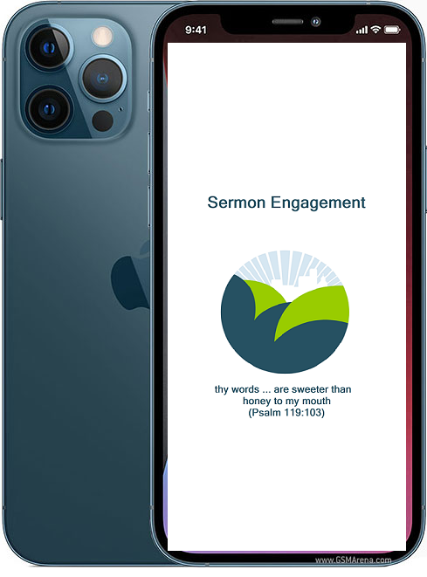
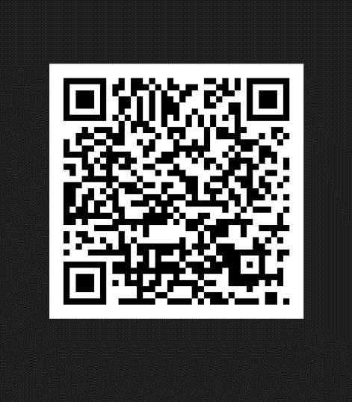
Check out the Sermon Engagement App Engage more deeply with the Word

